Slide 1

SANIYA TARUNNAM-22071A67B4
S.LALITHA GEETANJALI-22071a67B9

Slide 2

What is blockchain technology?
Blockchain technology is an advanced database mechanism that allows transparent information sharing within a business network.
A blockchain database stores data in blocks that are linked together in a chain.
The data is chronologically consistent because you cannot delete or modify the chain without consensus from the network.
As a result, you can use blockchain technology to create an unalterable or immutable ledger for tracking orders, payments, accounts, and other transactions.
The system has built-in mechanisms that prevent unauthorized transaction entries and create consistency in the shared view of these transactions.

Slide 3
HOW DOES BLOCKCHAIN WORK?
While underlying blockchain mechanisms are complex, we give a brief overview in the following steps. Blockchain software can automate most of these steps:
Step 1 – Record the transaction
A blockchain transaction shows the movement of physical or digital assets from one party to another in the blockchain network.
Step 2 – Gain consensus
Most participants on the distributed blockchain network must agree that the recorded transaction is valid. Depending on the type of network, rules of agreement can vary but are typically established at the start of the network.

Slide 4
Step 3 – Link the blocks
Once the participants have reached a consensus, transactions on the blockchain are written into blocks equivalent to the pages of a ledger book. Along with the transactions, a cryptographic hash is also appended to the new block. The hash acts as a chain that links the blocks together. If the contents of the block are intentionally or unintentionally modified, the hash value changes, providing a way to detect data tampering.
Thus, the blocks and chains link securely, and you cannot edit them. Each additional block strengthens the verification of the previous block and therefore the entire blockchain. This is like stacking wooden blocks to make a tower. You can only stack blocks on top, and if you remove a block from the middle of the tower, the whole tower breaks.
Step 4 – Share the ledger
The system distributes the latest copy of the central ledger to all participants.

Slide 5
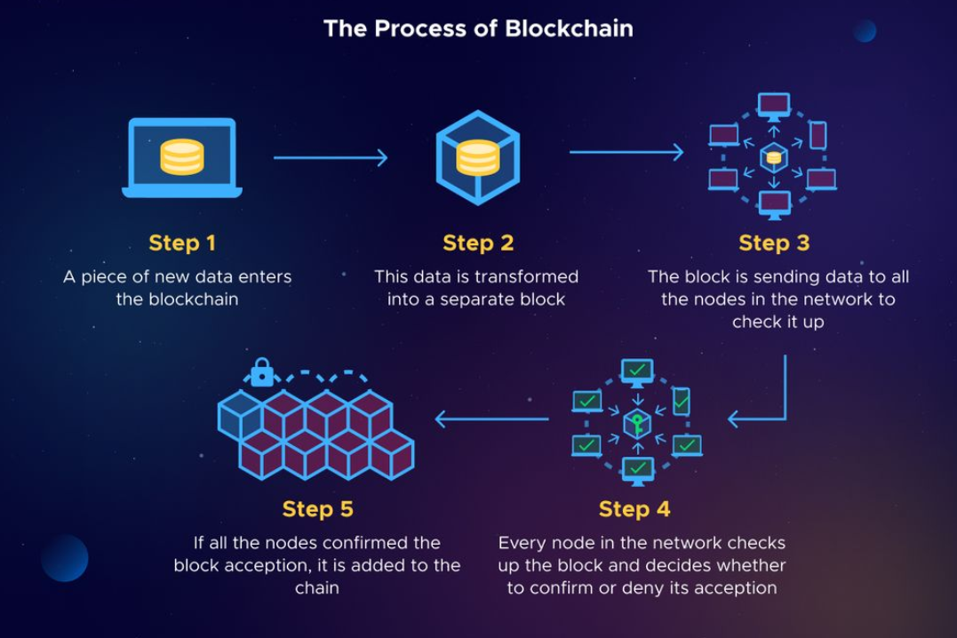
PROCESS OF BLOCKCHAIN

Slide 6
TYPES OF BLOCK CHAIN NETWORKS
There are four main types of decentralized or distributed networks in the blockchain:
Public Blockchain Networks: These are open and permissionless networks where anyone can participate, read, and validate transactions, exemplified by cryptocurrencies like Bitcoin and Ethereum.
Private Blockchain Networks: Controlled by a single organization, these networks restrict access and permissions, allowing only designated participants to interact with the blockchain, such as Ripple for business transactions.

Slide 7
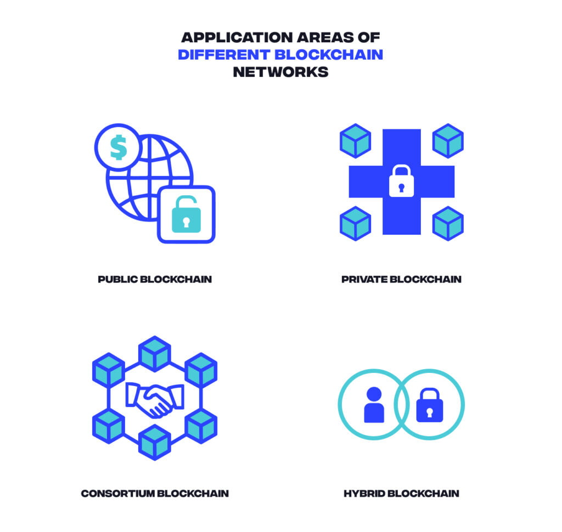
Hybrid Blockchain Networks: Combining features of both public and private blockchains, hybrid networks allow organizations to maintain private systems while offering public access to certain data, often utilizing smart contracts for verification.
Consortium Blockchain Networks: Governed by a group of preselected organizations, consortium blockchains distribute control and responsibility among members, making them ideal for industries where collaborative efforts are beneficial, like the Global Shipping Business Network.

Slide 8
Advantages of Blockchain Technology:
Get Rid of Middlemen: Eliminates the need for intermediaries, reducing costs and risks associated with trusting third parties.
Improve Data Quality: Enhances data integrity by filtering out low-quality information through automated verification processes.
Protect Against Hacking Attempts: Increases security as data is decentralized, making it difficult for cyberattacks to target a single point.
Reduce Operational Costs: Lowers expenses by facilitating peer-to-peer transactions without the need for centralized authority or transaction fees.
Transparent Recording System: Provides a public ledger of transactions that enhances transparency and accountability.

Slide 9
Disadvantages of Blockchain Technology:
Uncertain Regulations: The lack of clear regulations can create mistrust and hinder widespread adoption of blockchain technology.
Power Consumption: High energy requirements for maintaining numerous nodes in the network can lead to significant operational costs.
Scalability Issues: Limited transaction processing capacity may result in congestion and increased costs during peak usage.
Development Costs: Initial setup and integration of blockchain systems can be expensive and resource-intensive.
Social Resistance: Resistance from individuals or organizations due to fears of transparency and disruption of established norms.

Slide 10
How do different industries use blockchain?
Blockchain is an emerging technology that is being adopted in innovative manner by various industries. We describe some use cases in different industries in the following subsections:
Energy: Blockchain enables peer-to-peer energy trading platforms, facilitating easier access to renewable energy for consumers and producers
Finance: Financial institutions utilize blockchain for efficient online payments and account management. For instance, Singapore Exchange Limited improves interbank payment systems by addressing challenges like batch processing and manual transaction reconciliation.

Slide 11
Media and Entertainment: Blockchain systems help manage copyright data, ensuring fair compensation for artists. Sony Music Entertainment Japan enhances digital rights management efficiency through blockchain, leading to improved productivity and cost reduction.
Retail: Retailers employ blockchain to trace goods from suppliers to buyers. Amazon has patented a distributed ledger system to verify the authenticity of products sold on its platform, enabling participants to document their supply chain events securely.

Slide 12
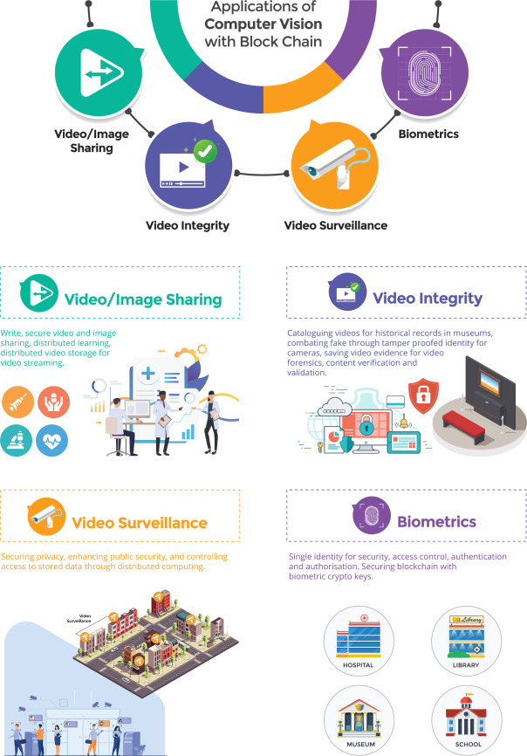
APPLICATION OF BLOCHCHAIN TECHNOLOGY
Video/Image Sharing: Secure and distributed sharing of videos and images, ensuring privacy and reliable storage for video streaming.
Video Integrity: Maintaining the authenticity of videos for purposes like historical record-keeping and video forensics, protecting against tampering and fake content. Video Surveillance: Enhancing public security by using blockchain to protect privacy, manage access, and secure surveillance data storage. Biometrics: Using blockchain to secure biometric data, ensuring reliable identity verification for access control in places like hospitals, schools, museums, and libraries.

Slide 13
CONCLUSION
Blockchain technology represents a transformative force across various industries, offering unparalleled security, transparency, and efficiency.
Its decentralized nature reduces the risk of fraud and manipulation, while smart contracts automate processes, streamlining operations and minimizing costs.
As blockchain continues to evolve, its potential applications—from finance and supply chain management to healthcare and beyond—will reshape how businesses and individuals interact.
By fostering trust and enabling secure transactions, blockchain is poised to become a foundational technology for the future, driving innovation and creating new opportunities in an increasingly digital world.

